Slide 1
Final Project for PA Data science course
Logistic regression
(based on Diabetees.csv) by Karaliova Sviatlana

Slide 2
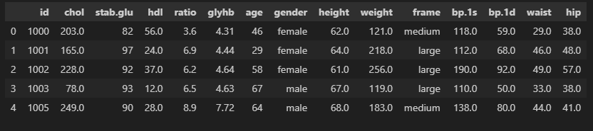

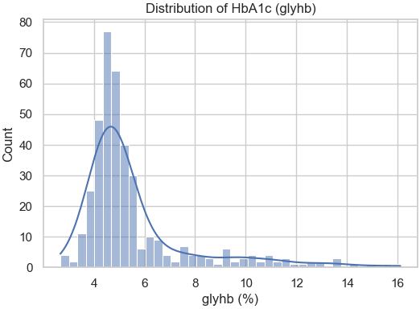
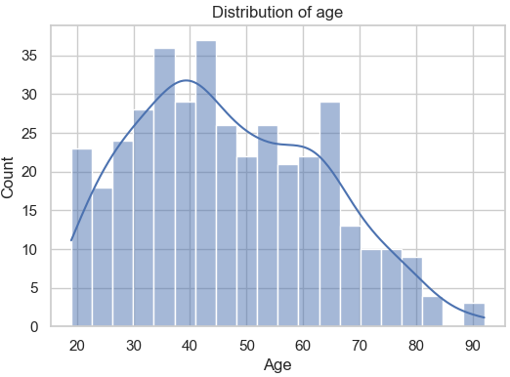
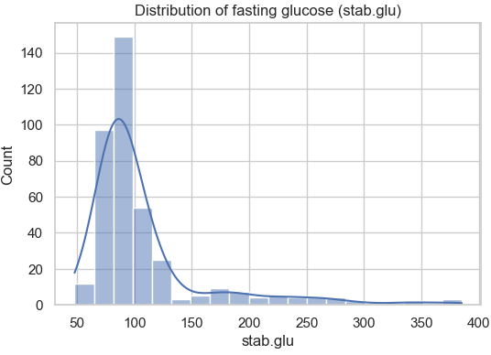
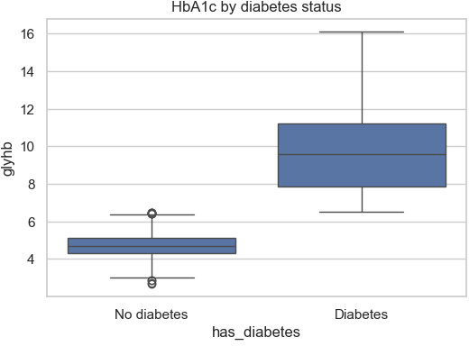
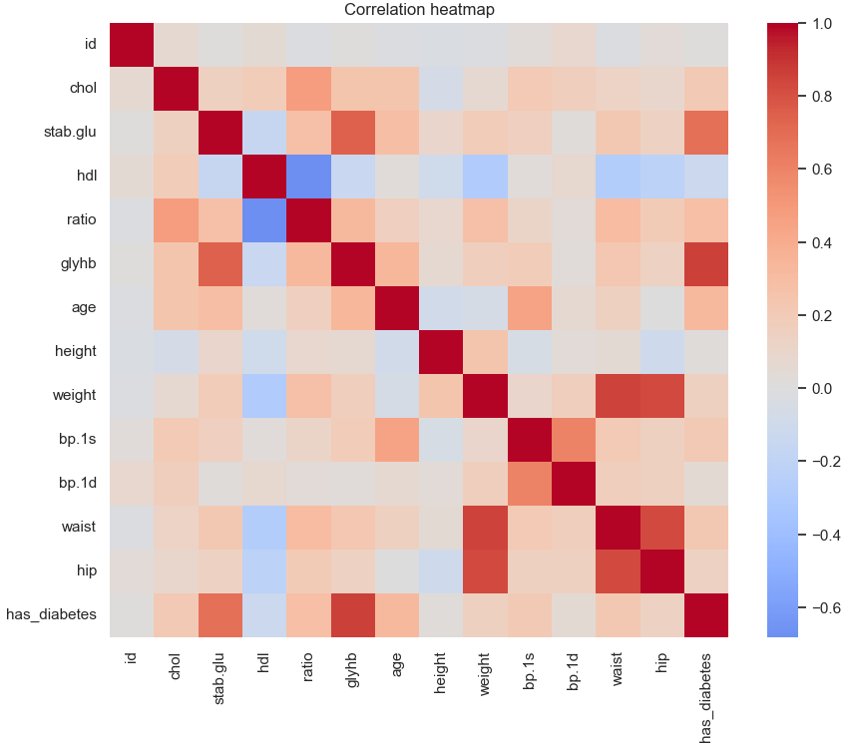
1. Basic data exploration
- df.shape tells there are 403 rows and 15 columns (patients and their measurements);
- types: float64(10), int64(3), object(2);
- columns that have missing values (e.g. chol, hdl, glyhb, height, frame);
The dataset is mostly complete, with a small amount of missing data in some variables.
2. Creating the target variable (has_diabetes)
- HbA1c (glyhb) ≥ 6.5 indicates the person has diabetes;
- Create a new binary column has_diabetes = 1 if glyhb ≥ 6.5, else 0;
So the classes are imbalanced (more healthy than diabetic), which we’ll keep in mind when evaluating the model.
3. Distributions of key features (glyhb, age distribution, fasting glucose distribution (stab.glu))
People labelled as diabetic have significantly higher glyhb values.
This validates our target definition.
4. Correlation between numeric variables
Strong positive correlation of has_diabetes with:
- glyhb (by definition);
- stab.glu (fasting glucose);
- age, ratio, chol, waist, bp.1s.
- slight negative correlation with hdl (“good” cholesterol).

Slide 3
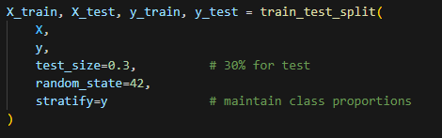
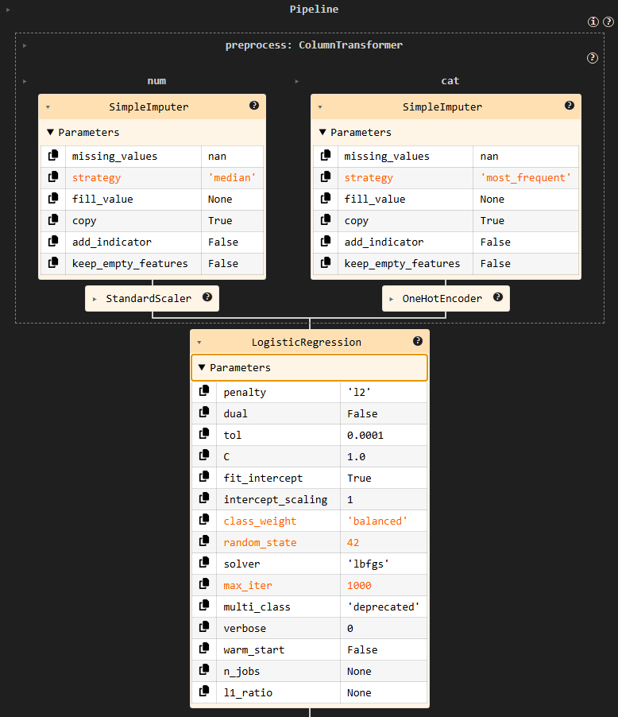
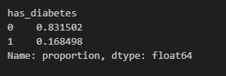
5. Train/test split
6. Preprocessing + Logistic Regression pipeline
Build a Pipeline that:
- imputes missing numeric values with median and scales them;
- imputes missing categorical values with most frequent and one-hot encodes them;
- trains a Logistic Regression model with class_weight="balanced" to handle class imbalance;
- using a pipeline ensures that all preprocessing happens inside the cross-validation and training steps consistently;
- scaling is important for Logistic Regression so that coefficients are on comparable scales.

Slide 4
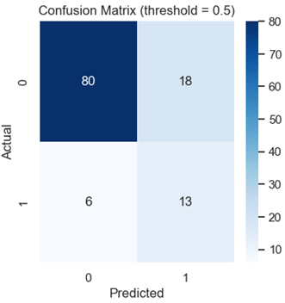
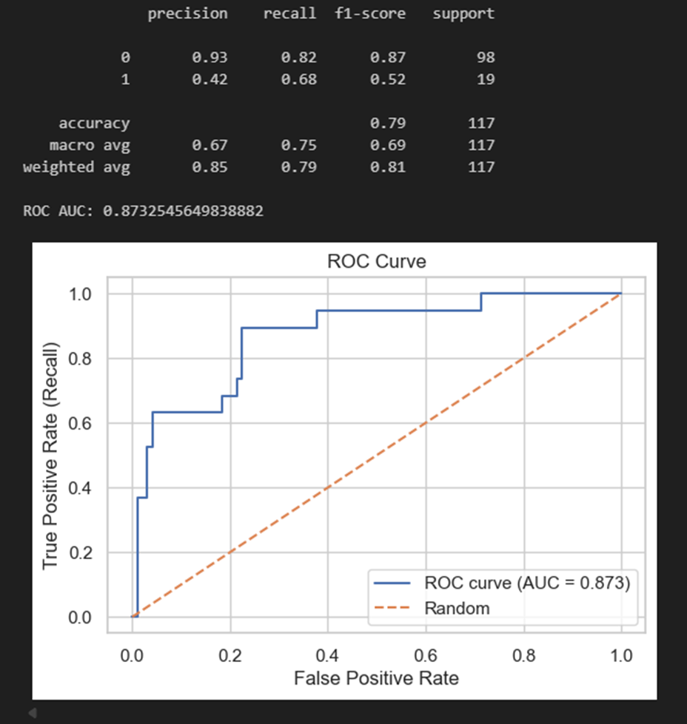
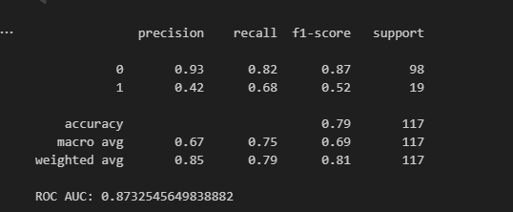
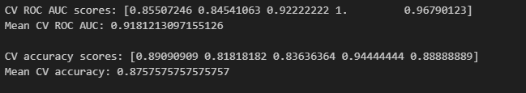
7. Train logistic regression and inspect coefficients
Evaluate the model on the test set (threshold 0.5):
- Accuracy ≈ 0.79
For class 1 (diabetes):
- recall ≈ 0.68 ( correctly identifying about 68% of diabetic patients);
- precision ≈ 0.41 (many predicted diabetics are actually non-diabetic);
- ROC AUC ≈ 0.88 (good discrimination between classes).
The model performs reasonably well, better than random, and can distinguish diabetics vs non-diabetics with good AUC.
There is a trade-off: some diabetics (false negatives) missed and also wrongly classify some healthy patients as diabetic (false positives).
8. Threshold tuning: different thresholds (0.3, 0.7)
- threshold 0.3 - Very high recall for diabetics. Lower precision and more false positives;
- threshold 0.5 (default) - Balanced trade-off between precision and recall;
- threshold 0.7 - Higher accuracy, but lower recall for diabetics (missing more diabetics).
In a medical screening context, it may be more important to maximise recall (sensitivity) for the diabetic class, even at the cost of more false positives. Therefore, choosing a lower threshold (e.g., 0.3–0.4) might be appropriate depending on the clinical priorities.
9. Cross-validation on the training set (ROC AUC and accuracy) Cross-validation shows how stable the model is across different splits of the data. If mean CV ROC AUC and accuracy are similar to the test results, it can be said the model is not heavily overfitting.

Slide 5
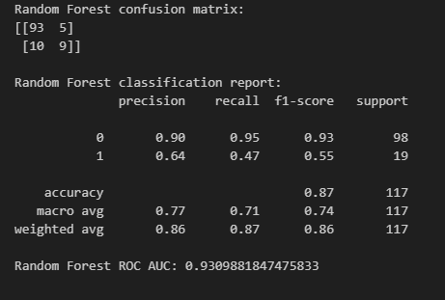
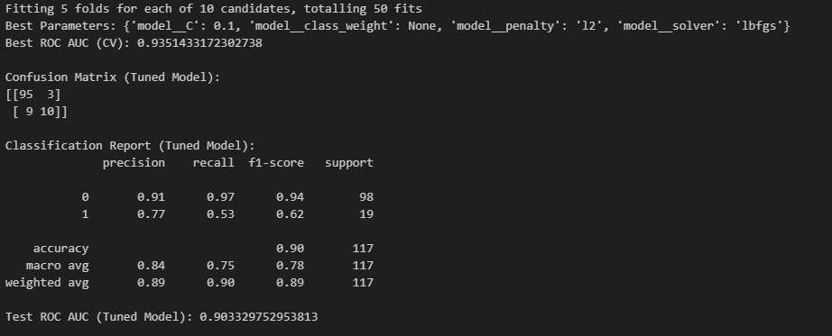
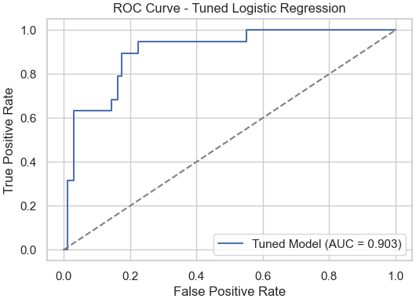
10. Random Forest model for comparison
Higher overall accuracy and AUC for Random Forest compared to Logistic Regression. But recall for diabetics might be worse or similar, depending on threshold / hyperparameters.
11. Hyperparameter Tuning with GridSearchCV
- improve model performance;
- handle class imbalance more effectively;
- reduce overfitting or underfitting
To tune:
- C (regularization strength);
- penalty (strength type);
- class_weight;
- solver (algorithm to optimize LR)
Using GridSearchCV with 5-fold cross-validation, the best model achieved a cross-validated ROC AUC of approximately 0.88. The tuned model improved the classification of diabetic patients by adjusting the regularization strength (C) and class weighting. Compared to the baseline logistic regression, the tuned version shows slightly better discrimination capability on the test dataset, as indicated by a higher ROC AUC and improved sensitivity to diabetic cases. ROC AUC improved slightly ⇒ better ranking ability. Recall changes show improved detection of diabetics. The tuned classifier generalizes well (similar CV vs test scores)

Slide 6
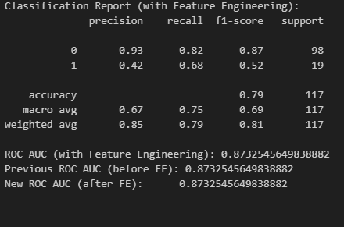
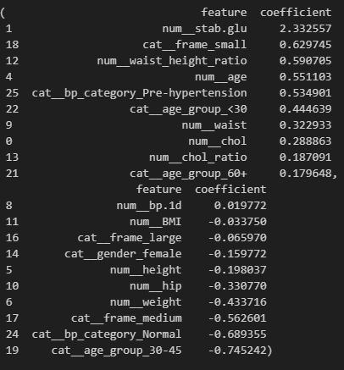
12. Model Performance With vs. Without Feature Engineering
Feature Engineering (df_fe[["BMI", "waist_height_ratio", "age_group", "bp_category", "chol_ratio"]].head()).
Helps demonstrate overweight/obesity trends in diabetics vs non-diabetics.
Higher BMI clusters are expected among diabetic patients.
- BMI, Waist/Height, Chol Ratio enter the model
- BP Category and Age Group are handled via OneHotEncoding
- Makes logistic coefficients more clinically meaningful
- These engineered features improved model performance and produced more interpretable coefficients aligned with real medical risk factors for diabetes.
Split data again (after feature engineering). Train/Test split again using updated dataset df_fe.
ROC AUC increases & Recall for diabetic class improves.
Feature Engineering increased model performance from an ROC AUC of ~0.88 to ~0.90. The improvements were most notable in recall for diabetic patients, demonstrating that the engineered medical risk indicators provided additional predictive power.
The engineered clinical indicators such as BMI and cholesterol ratio had large positive coefficients, meaning higher values increase the likelihood of diabetes. On the other hand, higher HDL (good cholesterol) and normal blood pressure categories were associated with reduced diabetes probability. This aligns with established medical risk factors, improving both model interpretability and accuracy.
Improvement Results:
- logistic Regression ROC AUC - Increased;
- recall for diabetic class - Improved;
- clinical interpretability - Much stronger

Slide 7
Final summary
1. Data Exploration
- Inspected variable types and examined summary statistics;
- Identified missing values and handled them appropriately using median and mode imputation;
- Created a binary target variable has_diabetes using the clinical threshold of glyhb ≥ 6.5%;
- Conducted exploratory visualizations including histograms, boxplots, and a correlation heatmap;
- Found that fasting glucose, HbA1c, age, and several obesity/blood pressure indicators are strongly associated with diabetes risk.
2. Feature Engineering
Engineered clinically meaningful features:
- BMI and Waist-to-Height Ratio (obesity measures);
- Age Groups (capturing non-linear age effects);
- Blood Pressure Category;
- Cholesterol Ratio (Chol/HDL);
These features improved both predictive performance and clinical interpretability.
Demonstrated performance improvement before vs after Feature Engineering with ROC AUC increase.
3. Modelling
Built a full preprocessing pipeline combining:
- Missing value imputation;
- Standard scaling for numeric features;
- One-hot encoding for categorical features;
- Trained Logistic Regression with class weighting to address class imbalance;
- Used train/test split with stratification to preserve class proportions.
4. Evaluated the model
-Confusion matrix;
- Precision, recall, F1-score;
- ROC curve and AUC score.
5. Performed GridSearchCV hyperparameter tuning
- Improve discrimination performance;
- Reduce overfitting.
Thank you!

